Slide 1
PhysioNet Challenge – AF classification
Speaker: Yu-Cheng, Lin
Advisor:
Date: 2019/11/09

Slide 2
Outline
Review
About this paper
Result
Bug of my code
CAM(class activation mapping)
Future work & discussion

Slide 3
Review
Data analysis
Brief study of R-peaks detecting algorithm
Implement Center wave feature method of paper 2 is impossible
Fail to implement [1]

Slide 4
About this paper [1]
Title: Towards Understanding ECG Rhythm Classification Using Convolutional Neural Networks and Attention Mappings
Author: Sebastian D. Goodfellow et. al
From: Proceedings of Machine Learning Research 85:1-18, 2018

Slide 5
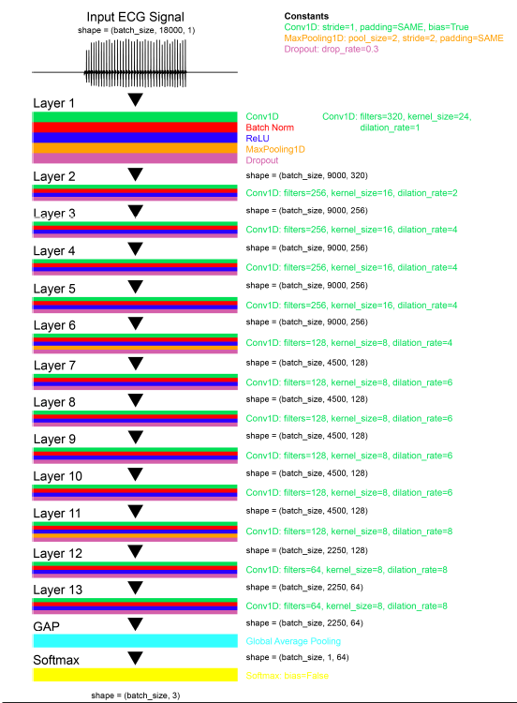
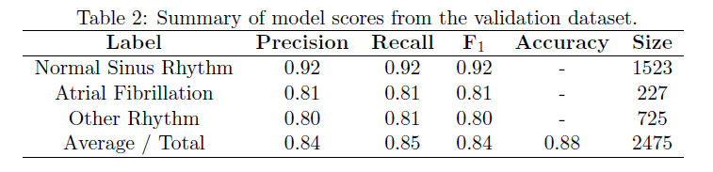
Model
Learning rate: 1e-3
Train validation split: 0.3
Weighted CE loss
100 epoch, batch size 10

Slide 6
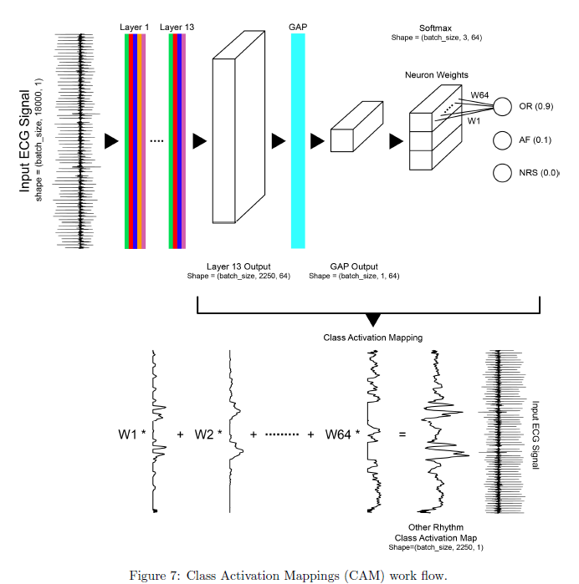
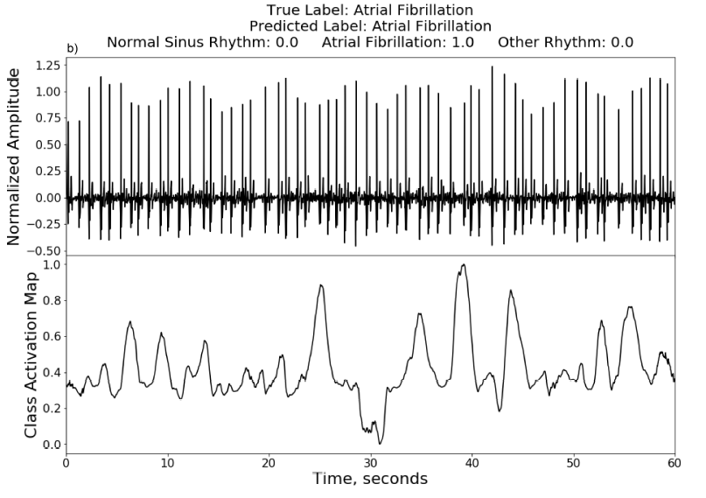
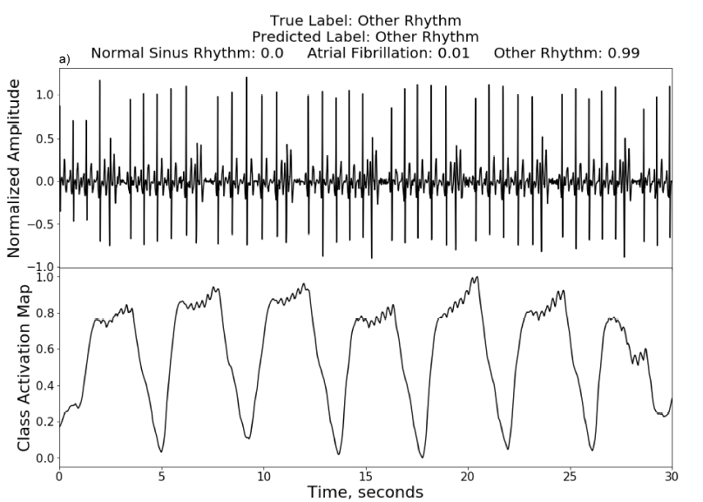
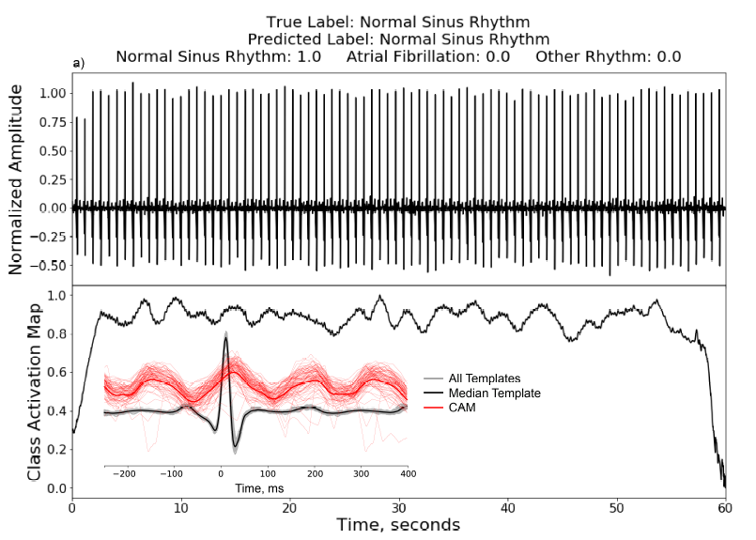

Slide 7
Details
Augmentation
Random scaling(with prob. 0.5) & scale uniformly distributed (0.5,2)
Random flipping
Padding both sides

Slide 8
Result
Model idx | L-rate | loss | filter | Other | Result
14 | 1e-3 | CE |  | RS+RF+P2 | 0.862@91
15 | 1e-3 | W-CE |  | RS+RF+P2 | 0.855/0.828@79(S148)
16 | 1e-3 | W-CE |  | RF+P2 | 0.816/0.758@11
17 | 1e-3 | W-CE |  | RS+RF+P1 | 0.801/0.729@8
18 | 1e-3 | W-CE | 3-45,3 | RS+RF+P2 | 0.848/0.812@76
CE: categorical crossentropy
WCE: weighted CE
3-45,3: bandpass 3-45 Hz w/ order 3
RF: random flip
RS: random scaling
P2: pad ‘0’ on both side
P1: pad ‘0’ back
(S): valid acc stuck
(X): fatal error
Valid_acc@epoch

Slide 9
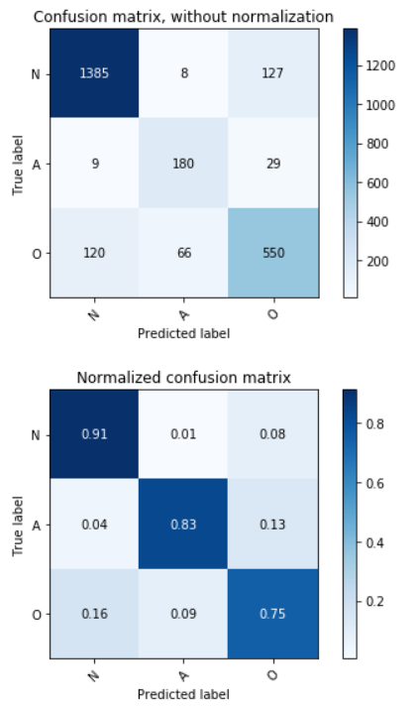
Result confusion matrix

Slide 10
Bug of my code
I used ‘pad_sequence’ function from ‘keras’ package which requires input type ‘array of list’, but actually my data type is ‘array of array’
Bug I found this time(fixed but not trained yet):
Formula of F1 score is slightly wrong

Slide 11
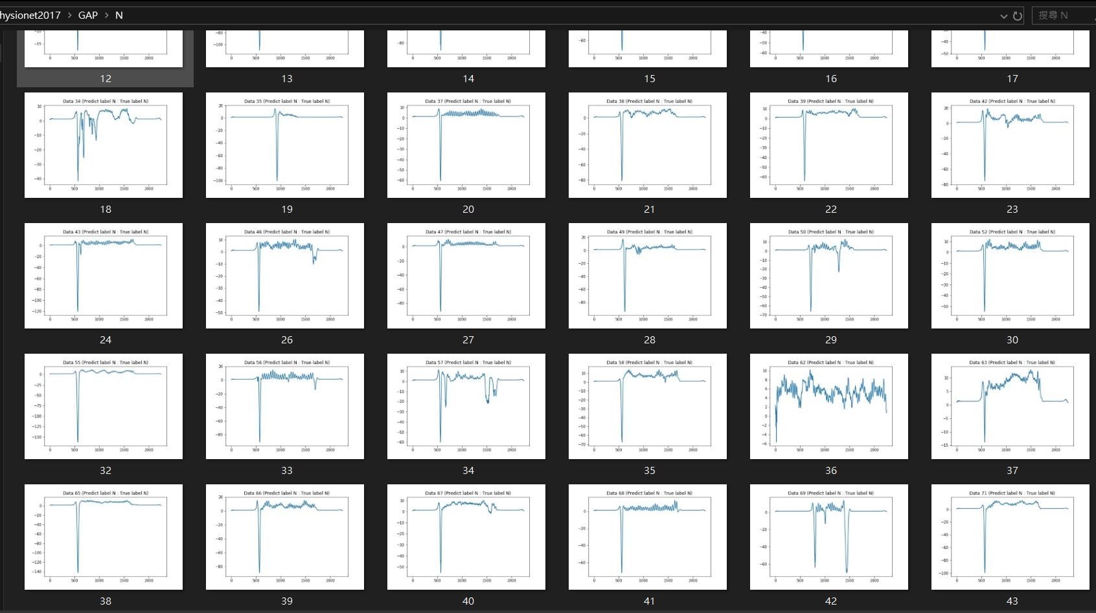
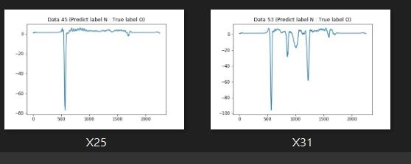
CAM(class activation mapping)
O
O

Slide 12
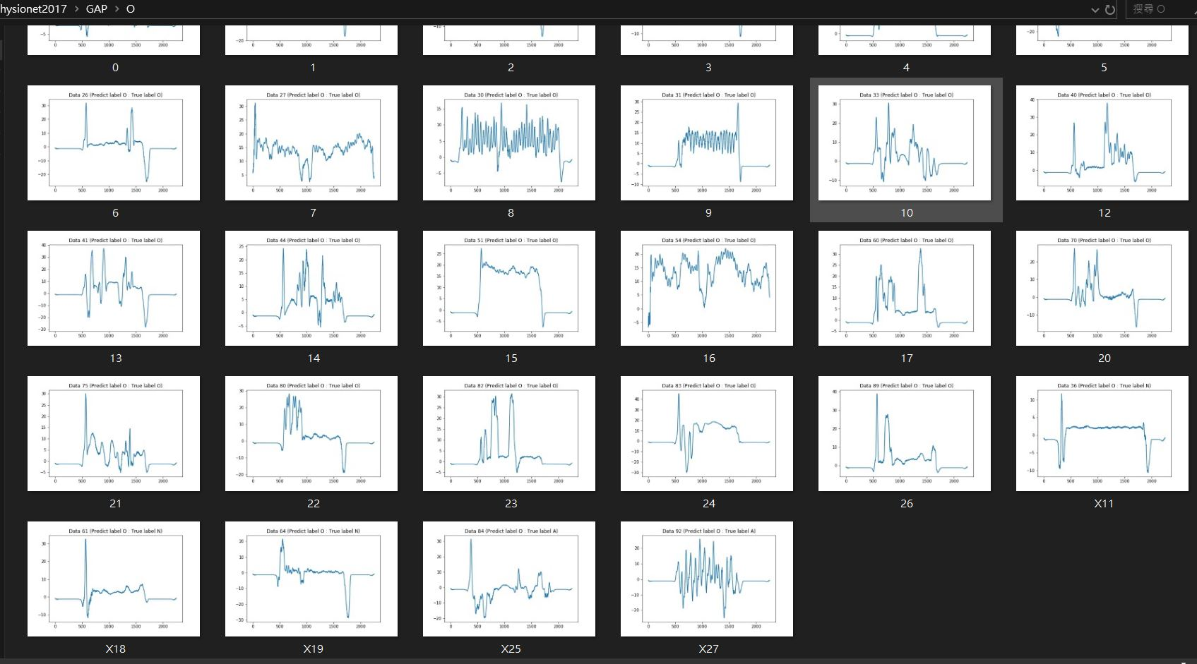
N
N
N
N
A
A

Slide 13
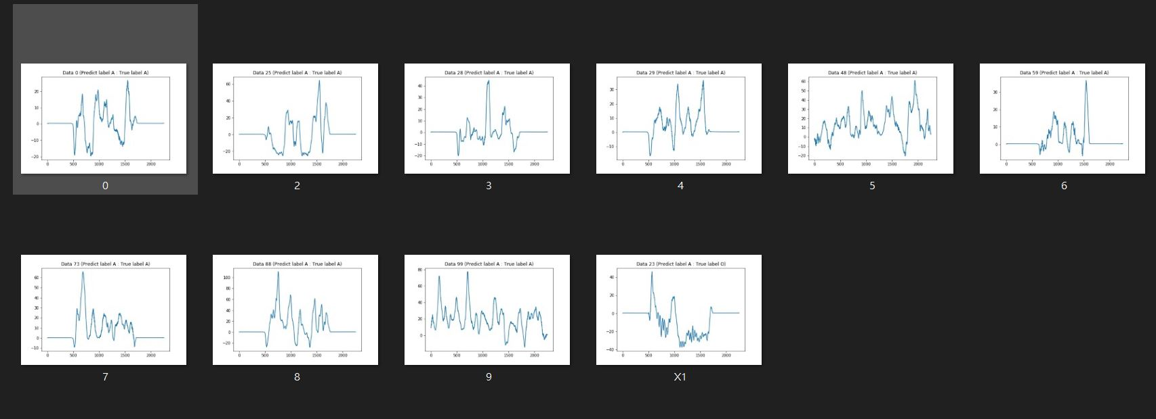
O

Slide 14
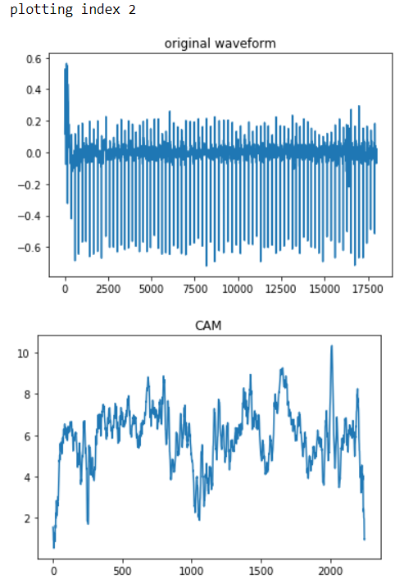
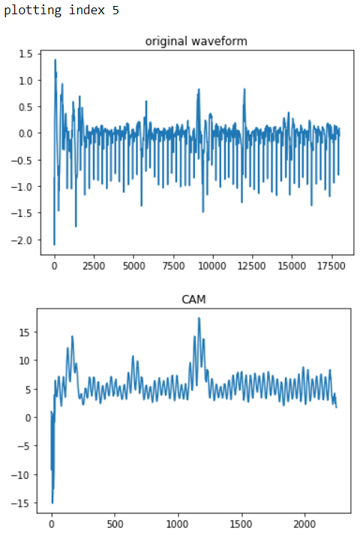

Slide 15
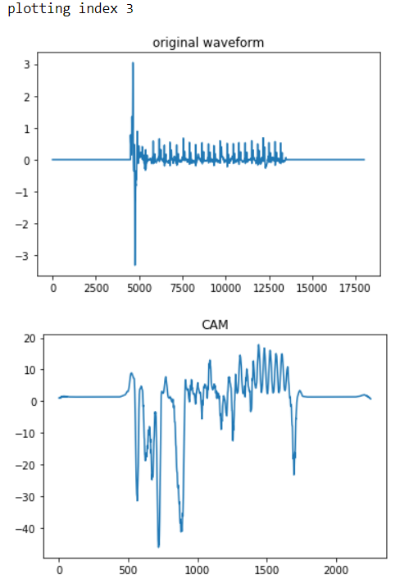
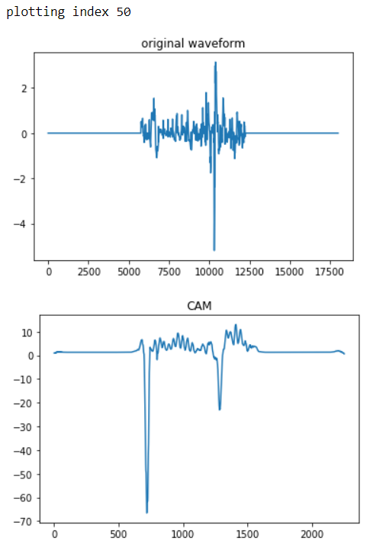

Slide 16
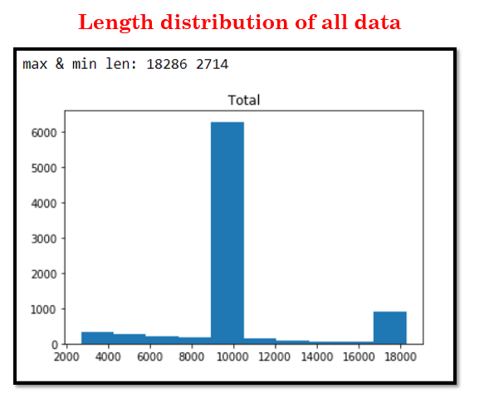
Future work & discussion
Cut the sequence?
Bert(Tiny?)?

